Slide 1
Hormones and the Endocrine System

Slide 2
What are we doing today?
Hormones can be lipid-soluble and able to cross cell membranes to bind with and activate intracellular receptors or, water-soluble and able to bind with and activate receptors on cell membranes, and require secondary messengers to affect cell functioning (SU)
Hormones secreted from the hypothalamus, pituitary, thyroid, parathyroid, pancreas and adrenal glands are involved in homeostasis by affecting specific target organs (SU)

Slide 3
Keywords
Endocrine:
Hormone:
Target cells/organ:
Paracrine:
Protein hormone:
Amine hormone:
Steroid hormone:
Receptor protein:
Negative feedback:

Slide 4
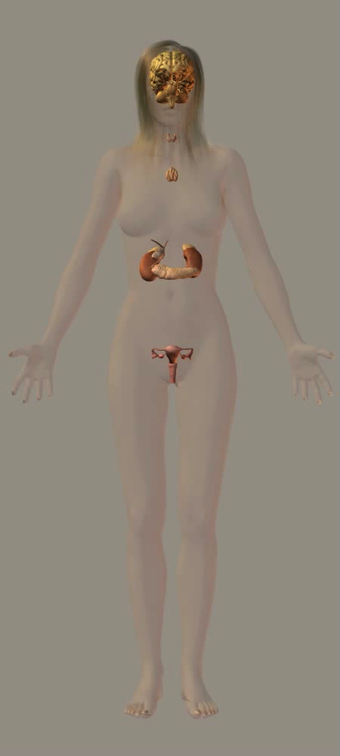
The Endocrine System
Endocrine glands are distributed throughout the body and are frequently associated with other organs of the body.
Endocrine organs are small in comparison to most other organs but their hormone secretions have wide ranging effects on the body by the production of hormones.

Slide 5
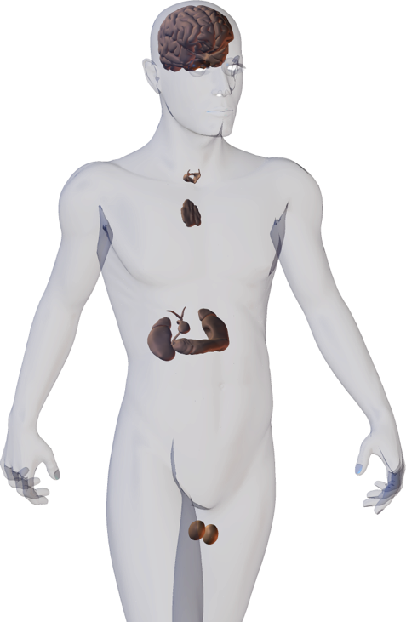



Endocrine Signaling
The endocrine system regulates the body’s processes by releasing chemical messengers called hormones into the bloodstream.
Hormones are produced in minute quantities yet can have a large effect on metabolism.
Endocrine organs may be stimulated by a hormonal, humoral or neural stimulus.
Hormonal stimuli
One hormone-producing gland induces another to produce its own hormones.
Humoral stimuli
Changes in levels of ions and nutrients in the blood stimulate the production of hormones by an endocrine gland.
Neural stimuli
Nerve fibers may stimulate hormone release.

Slide 6
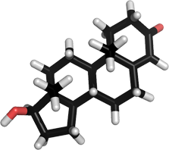
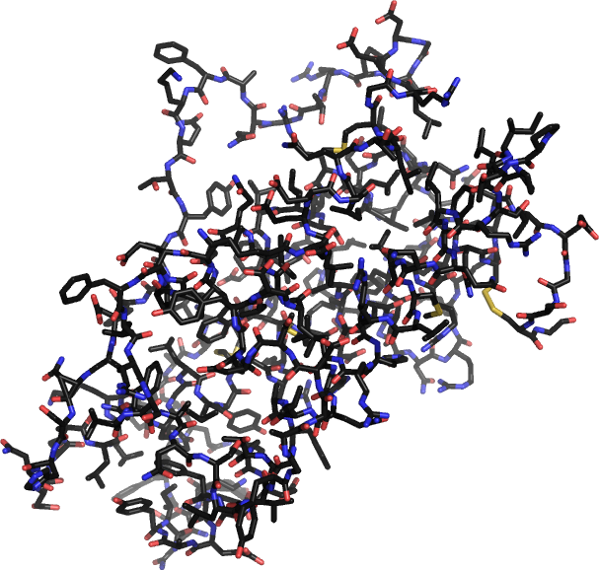
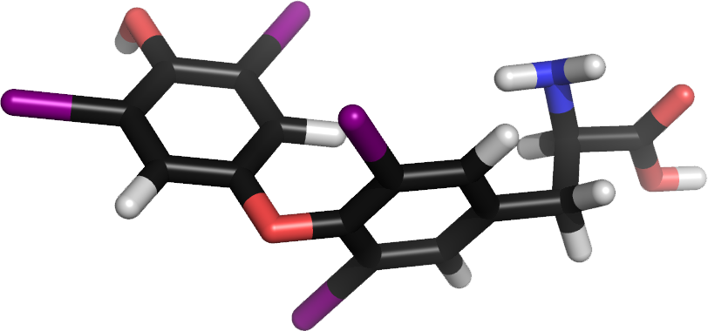
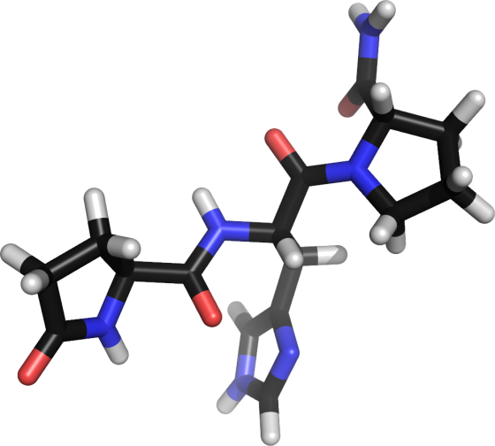
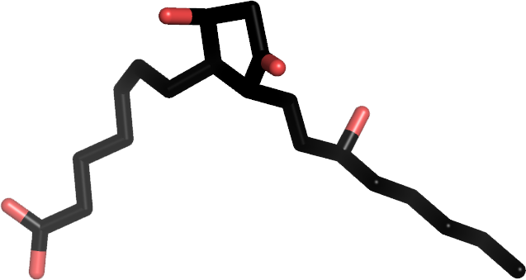
Hormones
Hormones are carried in the blood to exert a specific metabolic effect on target cells.
After exerting their effect, hormones are broken down and excreted.
Hormones can be amino acids, peptides, proteins, fatty acids, or steroids.
Thyroxine (amino acid)
Testosterone (steroid)
Prostaglandin (fatty acid)
Thyrotropin releasing hormone (peptide hormone)
Human growth hormone (protein)

Slide 7
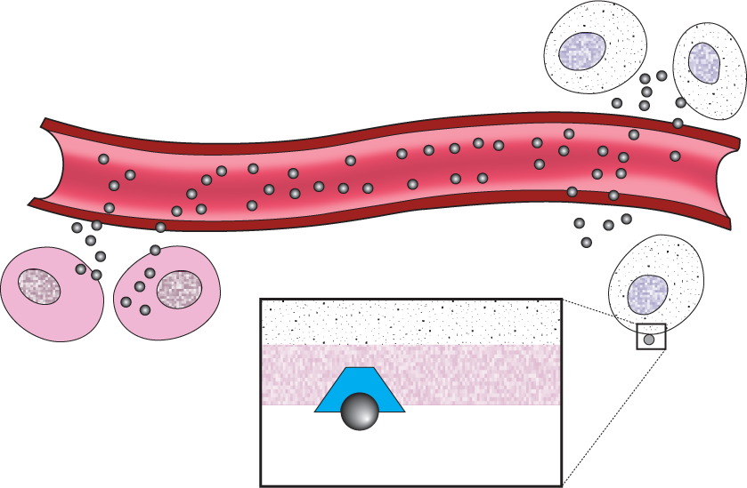
Hormone Action
Endocrine cells produce hormones and secrete them into the blood where they are distributed throughout the body.
Despite their wide distribution, hormones only affect specific target cells.
Hormone travels in the bloodstream throughout the body
Target cells
Endocrine cell secretes hormone into bloodstream
Blood vessel
Cytoplasm
Plasma membrane
The stimulus for hormone production and release can be:
– another hormone (hormonal)
– a blood component (humoral)
– neural (a nerve impulse)
Receptors on the target cell receive the hormone
Hormone receptor
Hormone molecule

Slide 8
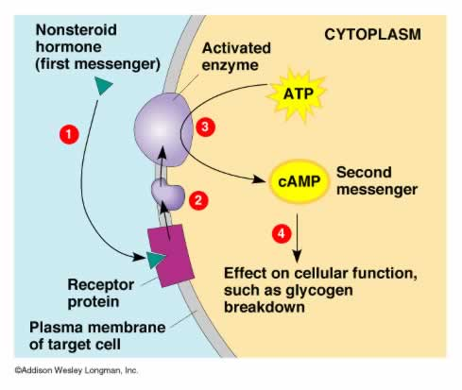
Amine /Protein Hormones
Non-steroid hormones, such as amines, peptides, and proteins, usually act by combining with specific receptor molecules located in target cell membranes.
Each receptor molecule is a protein that has a binding site and an activity site.
A hormone molecule delivers its message to its target cell by uniting with the binding site of a receptor.
This combination causes the receptor's activity site to activate other nearby membrane proteins.
An activated protein then diffuses along the cell membrane and stimulates another membrane protein that serves as an effector molecule.
Such an effector molecule may be an enzyme, and once it is stimulated, it causes changes in the concentrations to other cellular substances.
These substances serve as "second messengers" in the hormonal stimulation mechanism because they, in turn, induce cellular changes, which appear as responses to the original hormone.
Cellular responses to this second messenger mechanism include altering membrane permeability, activating various enzymes, promoting the synthesis of certain proteins, stimulating or inhibiting specific metabolic pathways, promoting cellular movements, and initiating the secretion of hormones or other substances.

Slide 9
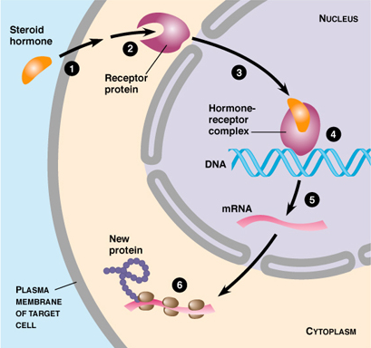
Steroid Hormones
Steroid hormones, unlike amines, peptides, and proteins, are soluble in the lipids that make up the bulk of cell membranes.
Steroid molecules can enter cells relatively easily by diffusion.
Once inside of a target cell, they may combine with specific nuclear protein molecules - the receptors.
The steroid-protein complex thus formed binds to particular regions of the target cell's DNA molecules, and activates specific genes.
The activated genes, in turn, cause the synthesis of particular kinds of messenger RNA (mRNA) molecules.
A messenger RNA molecule can leave the nucleus and enter the cytoplasm where it functions in the manufacturing of specific proteins.
Thus, steroid hormones influence their target cells by causing special proteins to be synthesized - proteins that act as enzymes and alter the rates of cellular processes, acts as part of membrane transport systems, or cause enzymes to be activated or inhibited.

Slide 10
Types of Hormones
 | Amines and Proteins | Steroids
Solubility
Membrane Permeability
Receptors
Action
Can be stored
Examples

Slide 11
Types of Hormones
 | Amines and Proteins | Steroids
Solubility | Soluble in water (polar) | Insoluble in water (non-polar, lipid soluble)
Membrane Permeability | Cannot pass through the membrane | Diffuse through the phospholipid bilayer
Receptors | Located on the outside of the cell membrane (need a secondary messenger inside the cell) Use receptor proteins embedded in the membrane | Intracellular receptors that may be on the mitochondria, other organelles or within the nucleus
Action | Causes changes in cell metabolism: Membrane permeability Activate enzymes Cause protein synthesis | Cause changes in gene expression: Cause proteins to be synthesized by expressing genes on DNA Epigenetics
Can be stored | Yes | No – made on demand
Examples | Any hormone not made by these glands → Epinephrine Thyroxin Oxytocin | All hormones made by the gonads and adrenal cortex: Testosterone Oestrogen Progesterone Aldosterone

Slide 12
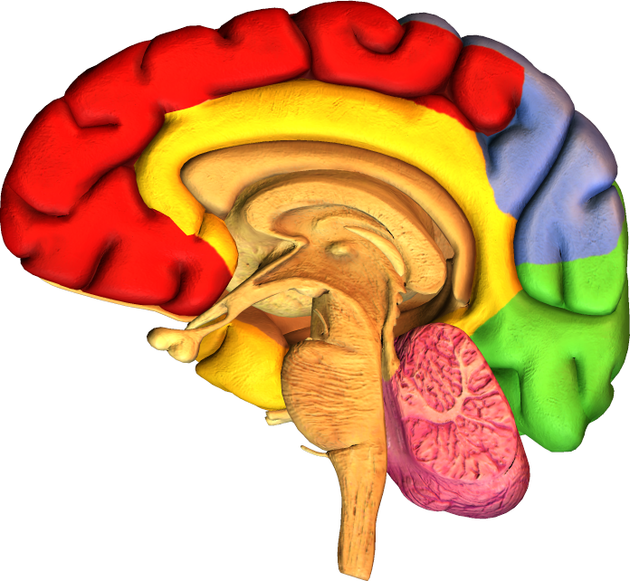
Hypothalamus
The hypothalamus is located below the thalamus, just above the brainstem and pituitary gland.
It receives information from sensory receptors and uses this information to to control and integrate many basic physiological activities, including:
temperature regulation
food and fluid intake
sleep
Hypothalamus

Slide 13
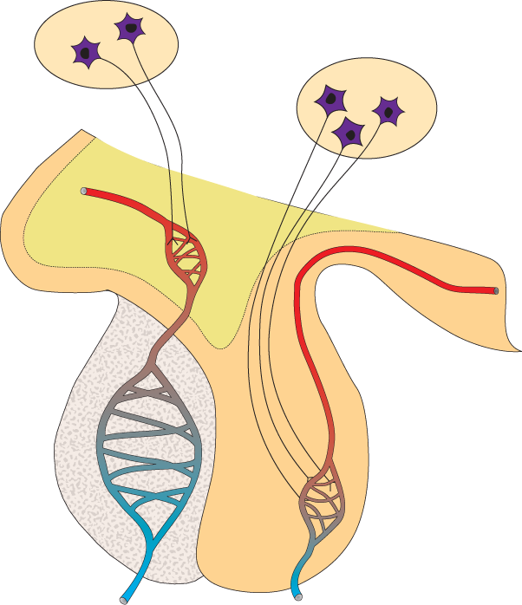
Role of the Hypothalamus
Neurosecretory cells
One of the most important functions of the hypothalamus is to link the endocrine system to the nervous system via the pituitary.
The hypothalamus contains neurosecretory cells.
These are specialized secretory neurons, which are both nerve and endocrine cells.
Hypothalamus
Anterior pituitary
(adenhypophysis)
Posterior pituitary(neurohypophysis)
Structure of hypothalamus and pituitary

Slide 14
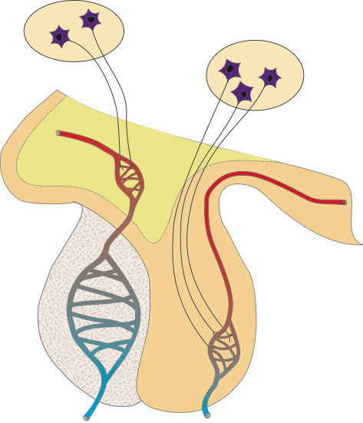
Hypothalamus Structure
Neurosecretory cells in the hypothalamus secrete neurohormones into capillaries. These releasing hormones control the release of hormones from the anterior pituitary.
Neurohormones from the hypothalamic neurosecretory cells supplying the posterior pituitary.
Artery
Portal vein links two capillary networks
Neurosecretory axons
Anterior pituitary is truly glandular and secretes hormones in response to the hypothalamic hormones.
Posterior pituitary is neural in origin
Releases at least seven peptide hormones, including GH, TSH, and ACTH
Stores and releases oxytocin and ADH produced by the hypothalamus.

Slide 15
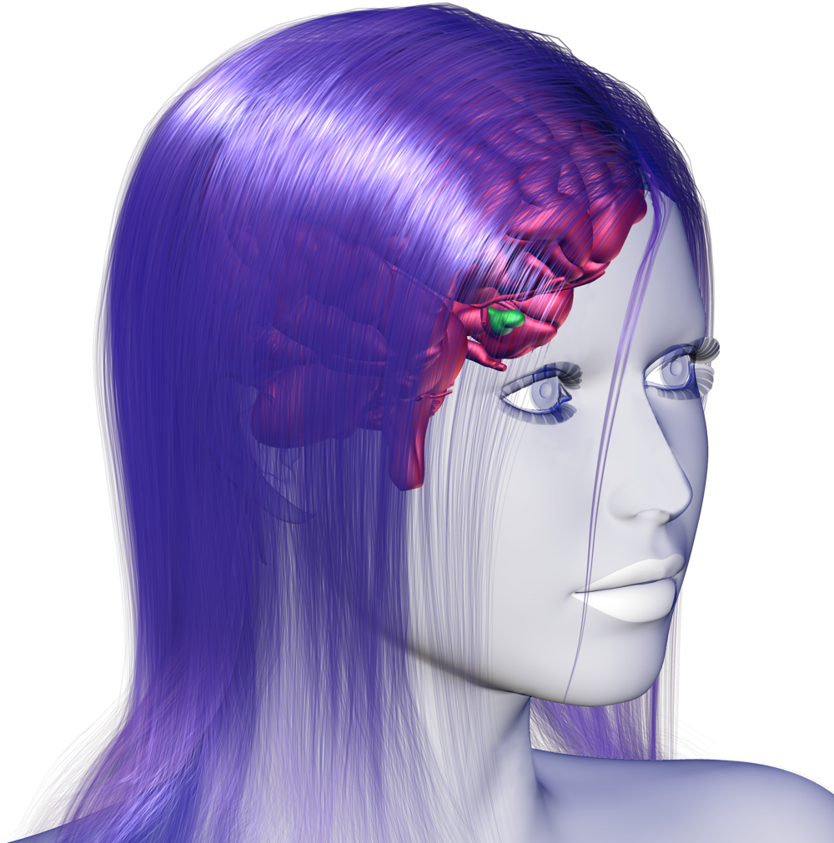
Hormones of the Pituitary
The pituitary gland is an endocrine gland about the size of a pea hanging from the inferior surface of the hypothalamus.
It pituitary comprises two distinct regions:
Anterior pituitary: glandular in origin
Posterior pituitary: neural in origin (an extension of the hypothalamus)
Posterior pituitary
Anterior pituitary

Slide 16
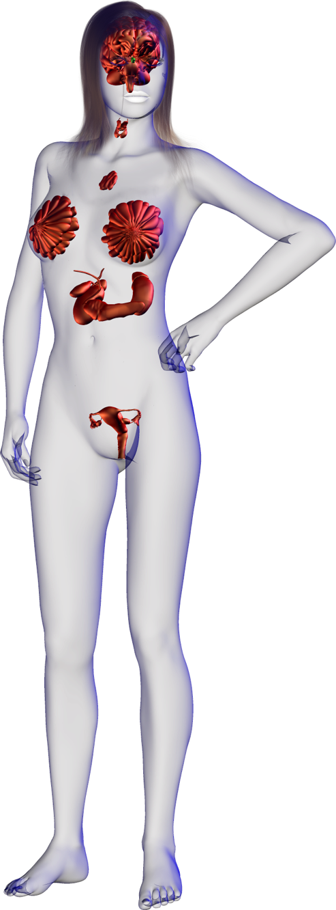
Anterior Pituitary
Thyroid Stimulating Hormone
Increases synthesis and secretion of thyroid hormones T3 and thyroxine) from the thyroid gland.
The anterior pituitary releases at least seven peptide hormones into the blood.
The release of these hormones is regulated by releasing and inhibiting hormones from the hypothalamus.
Growth Hormone
Stimulates protein synthesis and growth in most tissues. One of the main regulators of metabolism.
Adrenocorticotrophic Hormone
Usually abbreviated to ACTH, this hormone increases synthesis and secretion of hormones (aldosterone and cortisol) from the adrenal cortex.
Prolactin
Stimulates growth of the mammary glands and synthesis of milk protein.
Follicle Stimulating Hormone
In females: Stimulates maturation of the ovarian follicles.
In males: Increase the production of sperm in the seminiferous tubules
Luteinizing Hormone
In females: Stimulates secretion of ovarian hormones, ovulation, and formation of the corpus luteum.
In males: (ICSH) Stimulates synthesis and secretion of testosterone.
Melanophore Stimulating Hormone
Increases melanin synthesis and dispersal in the skin’s melanocytes.

Slide 17
Posterior Pituitary
The posterior pituitary develops as an extension of the hypothalamus.
The release of its two hormones oxytocin and antidiuretic hormone occurs directly as a result of nervous input to the hypothalamus.
Oxytocin
Acts on the mammary glands to stimulate milk ejection (let down).
Antidiuretic Hormone (ADH)
Acts on the collecting duct of the kidney to increase water reabsorption from the filtrate (urine).
Oxytocin
Acts on the uterus to stimulate smooth muscle contraction during labor.

Slide 18
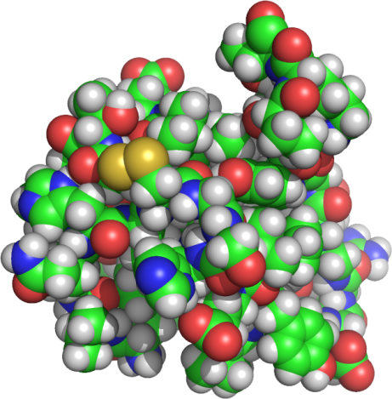
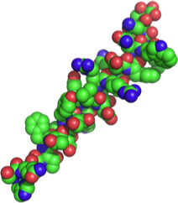
Antagonistic Hormones
The effects of one hormone are often counteracted by an opposing hormone.
Feedback mechanisms adjust the balance of the two hormones to maintain physiological function.
Example: insulin decreases blood glucose and glucagon raises it.
Raises blood glucose level
Increase in blood glucose stimulates insulin release
Decrease in blood glucose stimulates glucagon release
Glucagon
secretion
Insulin secretion
Lowers blood glucose level

